Slide 1
In-class activity: Debugging
Dr. Ab Mosca (they/them)
Slides based off slides courtesy of Jordan Crouser (https://jcrouser.github.io/)

Slide 2
RECAP: the programming process

Slide 3
RECAP: the programming process

Slide 4
Fun history: the term “debug”
RDML Grace M. Hopper
b.1906 – d.1992
Notes:
The term "bug", in the sense of "technical error", dates back at least to 1878 when it appeared in a private letter written by Thomas Edison. However, the terms "bug" and "debugging" with respect to computation are popularly attributed to Admiral Grace Hopper, the same person for whom the Annual Grace Hopper Celebration of Women in Computing is named. In 1946, when Admiral Hopper was released from active duty, she joined the Harvard Faculty at the Computation Laboratory where she continued her work on the Mark II and Mark III. Operators traced an error in the Mark II to a moth trapped in a relay. This bug was carefully removed and taped to the log book along with the notation "First actual case of bug being found.” This log book, complete with attached moth, is part of the collection of the Smithsonian National Museum of American History.^{[11]}

Slide 5
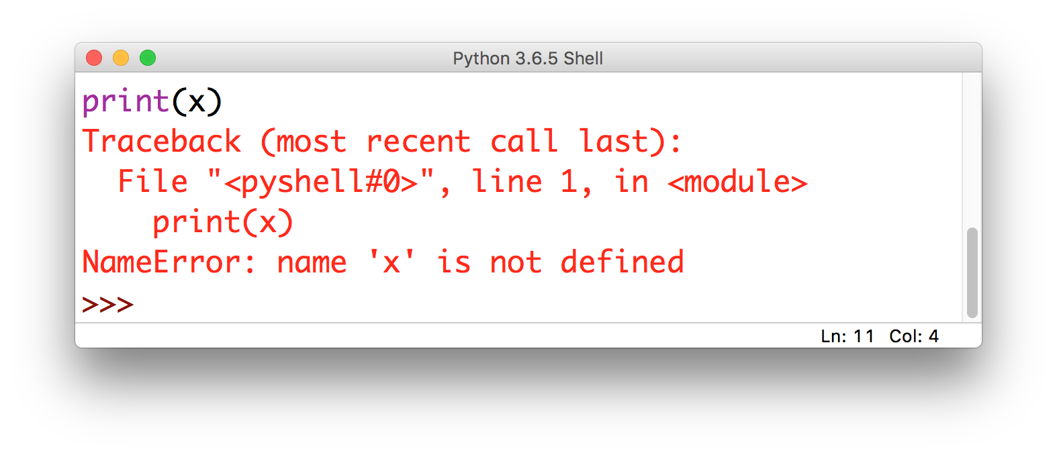
Some problems are obvious
this is called
an Exception

Slide 6
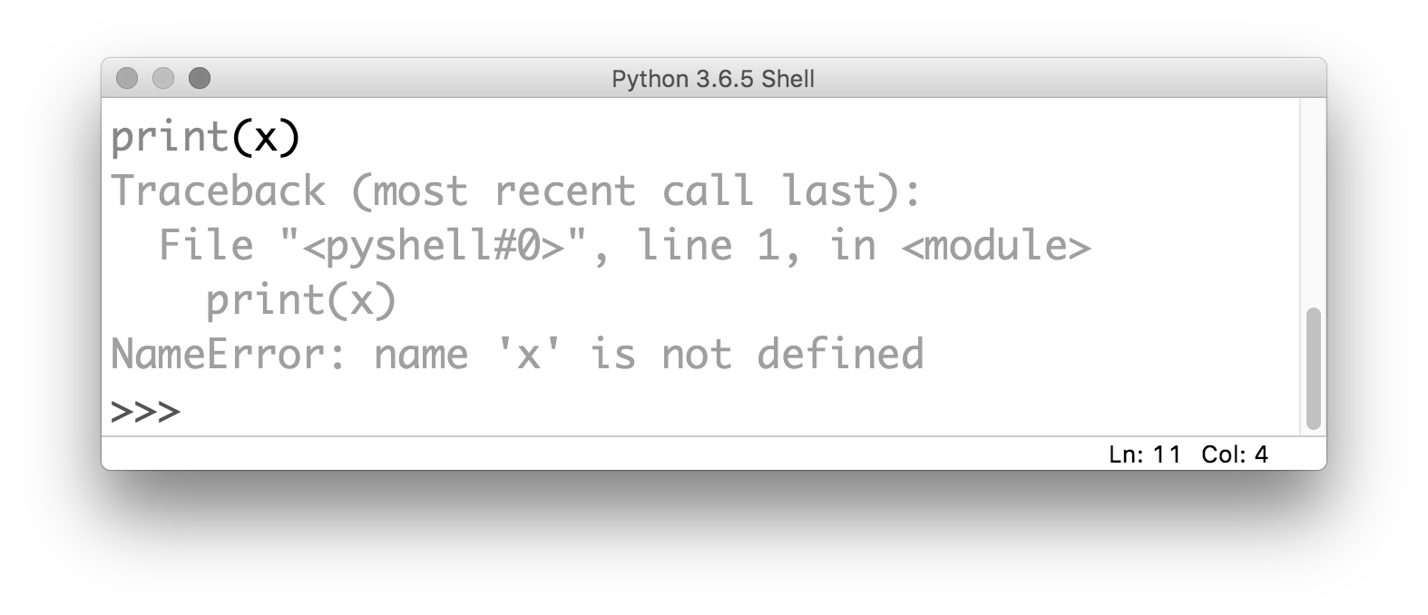
Some problems are obvious
the kind of error gives you
a clue about what the problem is

Slide 7
Some problems are obvious
it also tells you where the problem is
(but be careful!)

Slide 8
Common Exceptions
NameError: raised when Python can’t find the thing you’re referring to (a variable or a function)

Slide 9
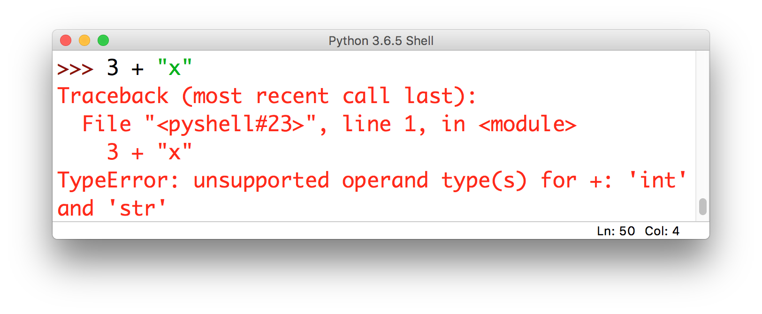
Common Exceptions
TypeError: raised when you try to perform an operation on an object that’s not the right type (i.e. a string instead of a number)

Slide 10
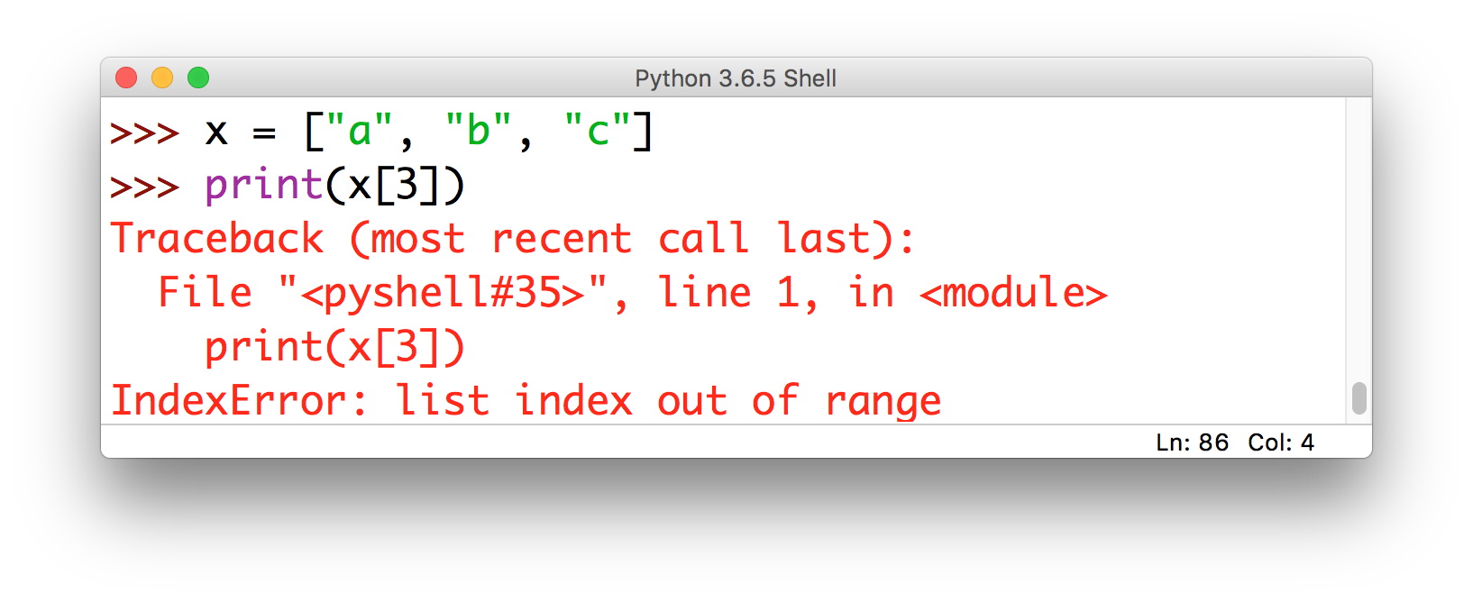
Common Exceptions
IndexError: raised when you try to use an index that’s out of bounds

Slide 11
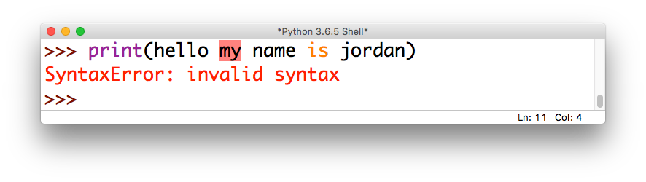
Common Exceptions
SyntaxError: raised when you try to run a command that isn’t a valid Python statement

Slide 12
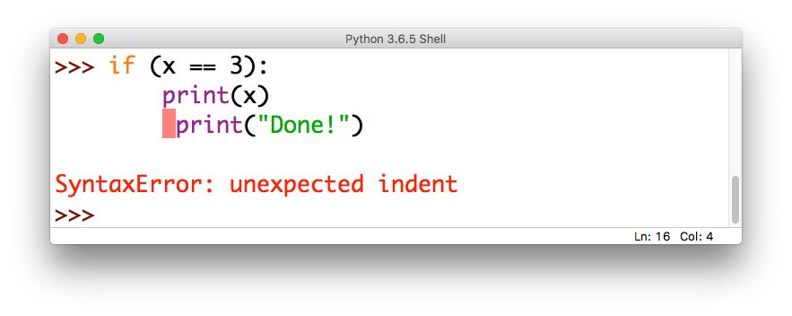
Common Exceptions
SyntaxError: also raised if your indentation is messed up (this is a special kind of SyntaxError called an IndentationError)

Slide 13
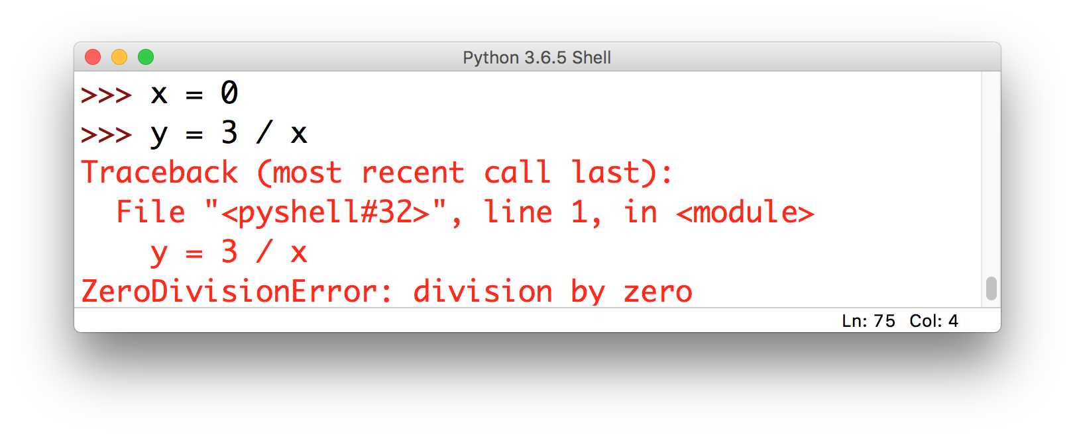
Common Exceptions
ZeroDivisionError: raised when you try to divide by zero (or do modular arithmetic with zero)

Slide 14
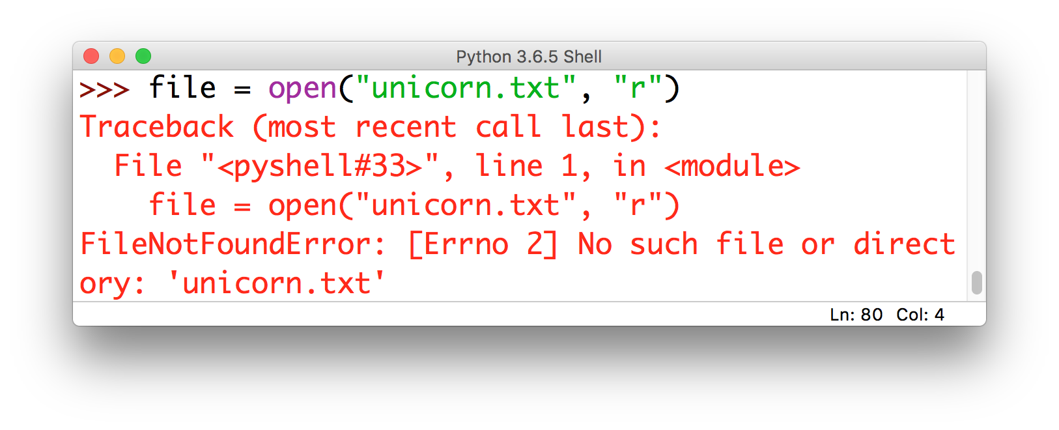
Common Exceptions
FileNotFoundError: raised when Python can’t find the thing you’re referring to (a file)

Slide 15
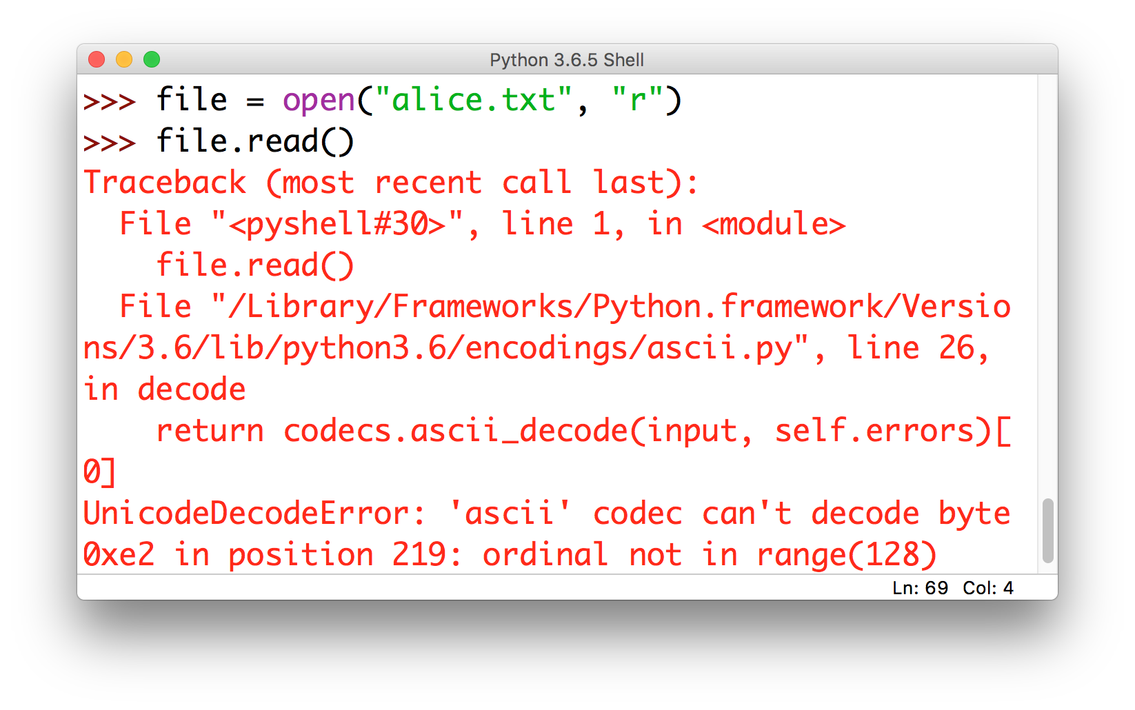
Common Exceptions
UnicodeDecodeError: raised when you try to read a file that has weird characters in it (most common culprit: apostrophe vs. the single quote)

Slide 16
Less common Exceptions
Did your program throw an Exception not listed here?
Look it up at:
https://docs.python.org/3/library/exceptions.html

Slide 17
Exceptions = relatively easy to fix
Why would I say that?
What’s the alternative?
(Hint: we looked at an example last week)

Slide 18
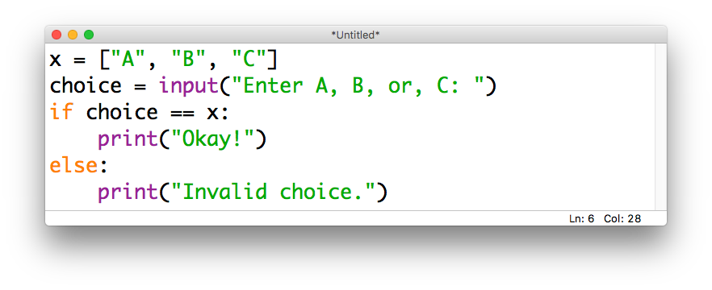
Logical errors
Mistakes in the reasoning behind the code (though the statements are valid and there are no Exceptions), e.g.
perfectly valid
(just not what we wanted)

Slide 19
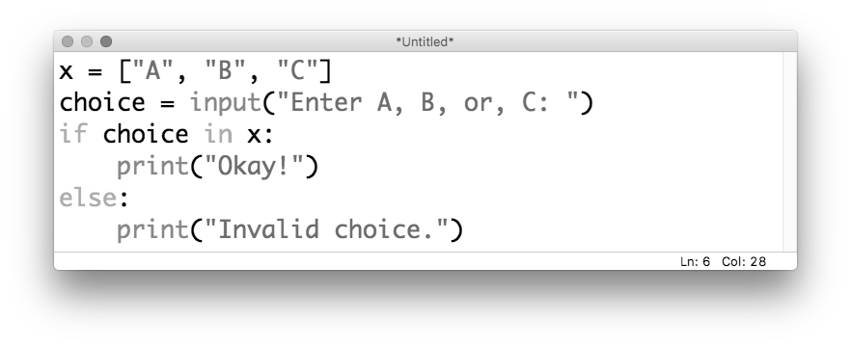
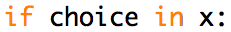
Logical errors
Mistakes in the reasoning behind the code (though the statements are valid and there are no Exceptions), e.g.
what we were
actually going for

Slide 20
An analogy
Syntactic Error
Their is no
reason to be concerned.
Logical Error
If an animal is green, it must
be a frog.

Slide 21
Discussion
How do you find and fix logical errors?

Slide 22
Step 1: map out the code
It is impossible to debug code that you don’t understand (and it’s possible to not understand code even if you wrote it!)
It’s often helpful to map out how the code fits together:
main()
printGoodbye()
printHello()

Slide 23
Step 2: “rubber ducking”
Still stuck? Try explaining it to someone else (or historically, to a rubber duckie)
This is the debugging equivalent of pair programming
“Okay, so first we
are going to round() the user’s input and then
...oh wait…
I think maybe the problem is that I forgot to eval() the input first, so it’s
still a string!

Slide 24
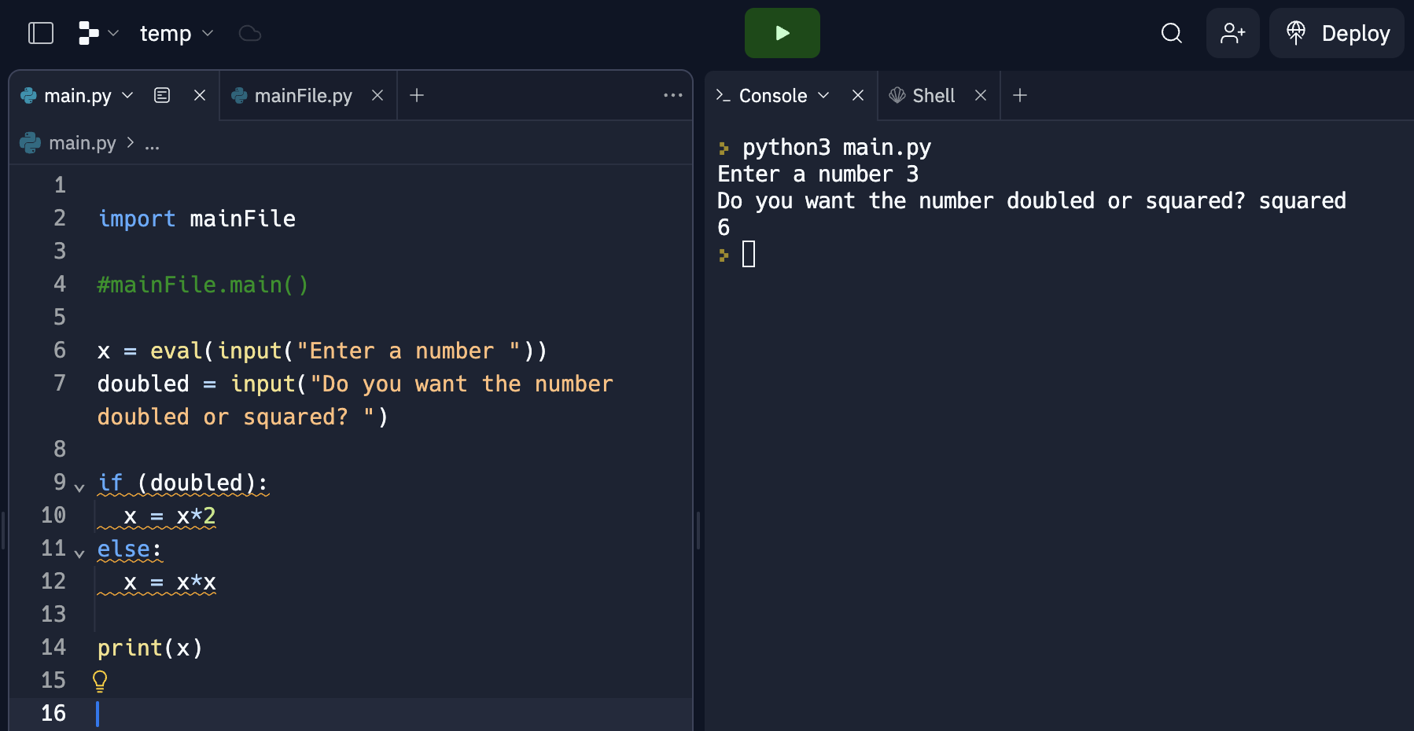
Step 3: add print() statements
Not sure exactly where things are going wrong?
Add print() statements to leave a “trail” on the console

Slide 25
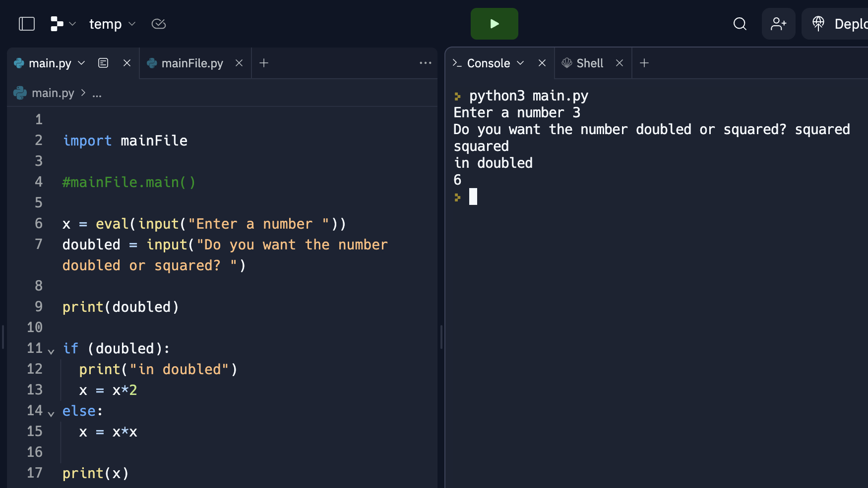
Step 3: add print() statements
Not sure exactly where things are going wrong?
Add print() statements to leave a “trail” on the console

Slide 26
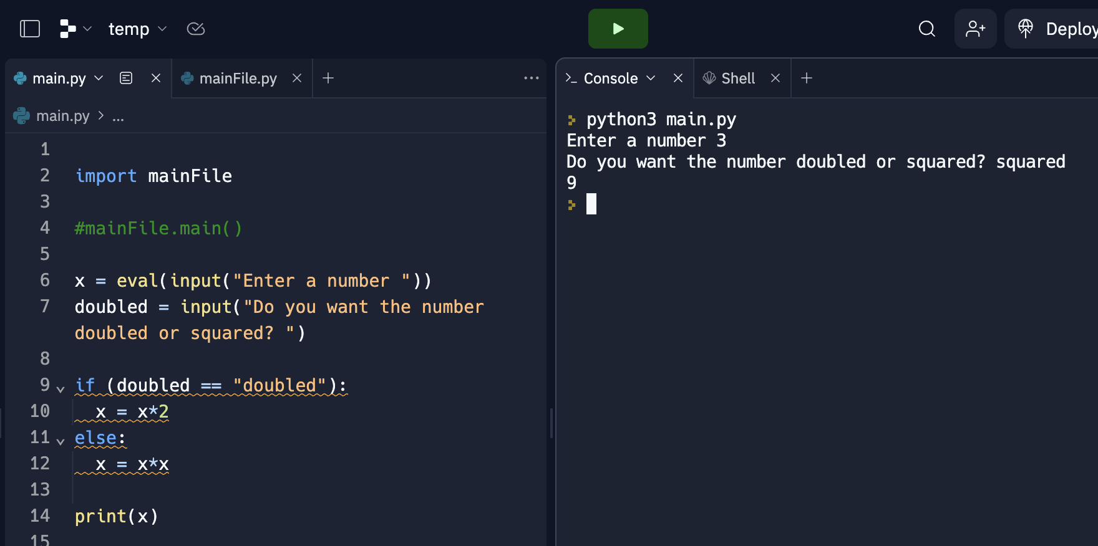
Step 3: add print() statements
Not sure exactly where things are going wrong?
Add print() statements to leave a “trail” on the console

Slide 27
Takeaways
This is a really quick crash course in basic debugging
There are lots of other techniques for both dealing with and preventing bugs, but for now this will suffice
The most important part is to understand:
what the code is trying to do
what the code is actually doing
Tips:
change one thing at a time
keep track of what you change!

Slide 28
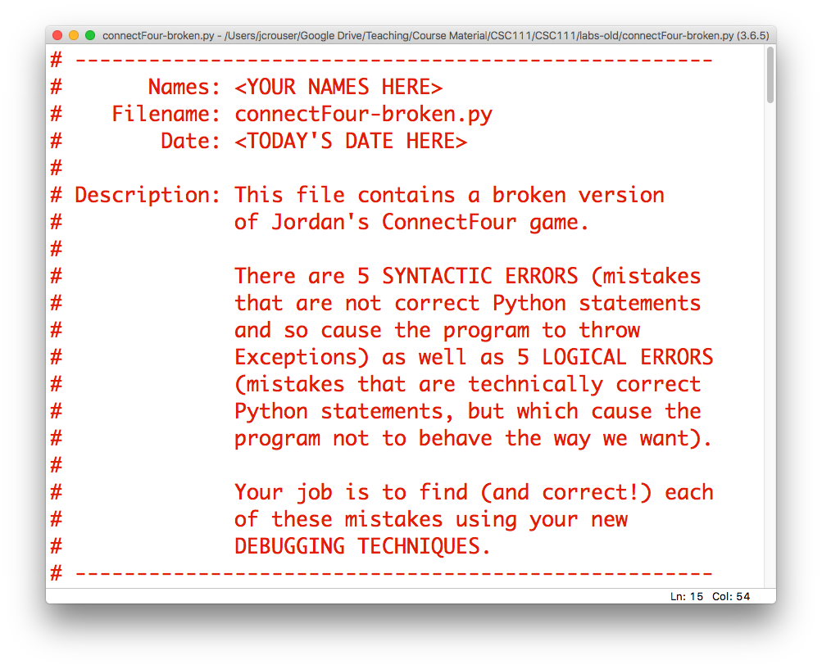
Your task

Slide 29
Discussion
What did you find?

